Slide 1
CS-3331 Group 2 Project Proposal
HANOI WORLD – A World Model Framework for Training Autonomous Self-Driving Cars In Hanoi

Slide 2
Member List
Dat Tran Tien ^{(*)}
Nguyen Khanh Viet Dung
Nguyen Hai An
Nguyen Duy Duc
Notes:
(*): Denoting the Team Leader
All member sharing similar contribution

Slide 3
Table of Content
Problem Statement & Motivation
Relevant Work
Methodology
Proposed Plan on Experimentation

Slide 4
Problem Statement & Motivation
Currently there are 2 main methods for training an Autonomous Vehicle Controller
  Supervised Learning (use a large amount of labeled data)
  Reinforcement Learning (Trial & Error a lot)
Both these methods are ineffective & expensive -> need a better training paradigm

Slide 5
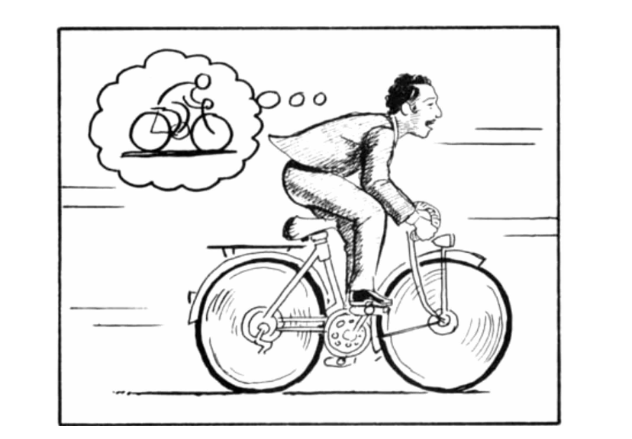
Problem Statement & Motivation
Humans can learn driving skills adaptively, using their imagination on possible scenarios
Better at preventing danger while attaining new skills
Cost effective & Safety for A.V manufacture & driver.
World Model Concept Demonstration From (Ha & Schmidhuber, 2018)

Slide 6
Problem Statement & Motivation
The concept of model training using its own imagination image on world perception = World Model as the A.V training simulation
So the problem we are trying to solve
  How to design the World Model Simulation, so that the A.V controller can be trained on such that the simulation has to be robust, efficient, and accurate
Notes:
Robust: The agent hard to hacking the World Model for optimizing it’s training objective
Efficient: The training shall be computation & memory optimized
Accurate: the latent result of the world model shall reflect the actual real-world & close to the real world as possible

Slide 7
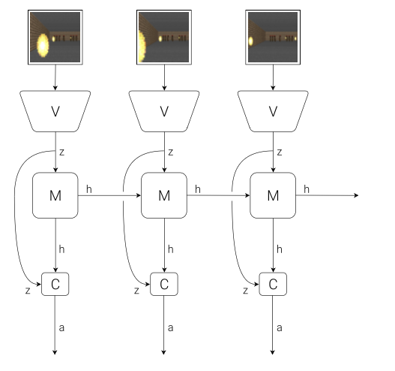
Relevant Works
World Model fundamentals contain 3 components: [1]
  Vision (VAE / CNN/ Autoencoder)
  Memory (RNN / Sequential Models)
  Controller (Linear Layer/ Multi-layer-perceptron)
World Model Initial Architecture (Ha & Schmidhuber, 2018)
Notes:
Vision (some call this Perception/ Observer)
Memory (remember the last state of the World that the model been experienced)
Controller (making downstream decision using Vision & memory input)
[1]: D. Ha and Schmidhuber (2018, p.2)

Slide 8
Relevant Works
Later findings do enhance & make the suggested architecture more sophisticated [2]
  Add regularization cost to latent
  Stabilize embedding and action selection
  Redesign memory for hierarchy
  Enable long-term reasoning ability
  Integrate multi-modal observers (text, image, kinematic, etc.)
Notes:
[2]: Lecun (2022)

Slide 9
Relevant Works
The architecture of JEPA supports the prediction of cross-domain embedding on latent features [2, 3]
  Ex: Guessing Text Semantic latent features using images latent features
JEPA: Joint Embedding Predicitve Architecture
Multiple JEPAs connected & nested on other can create the pattern of hierarchical reasoning with difference level of feature abstraction [2]
For Multiple Step latent yielding - we leverage the usage of Reccurent Network as RSSM in [4]
Notes:
[2]: Lecun (2022)
[3] (Assran et al., 2023)

Slide 10
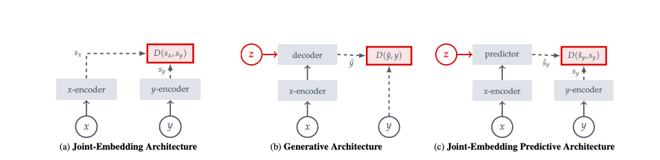
Three different types of architecture (JEPA – c)
Images from (Assran et al., 2023) [14]

Slide 11
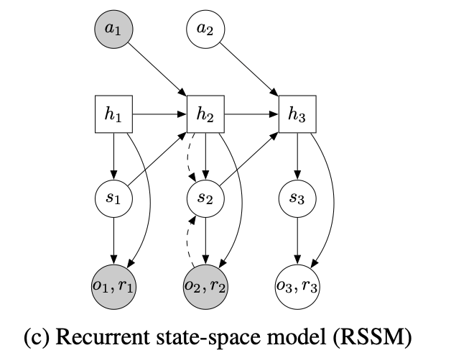
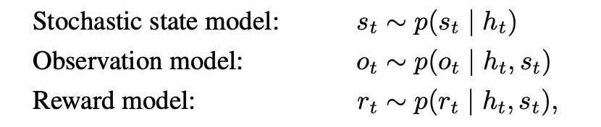
Recurrent State-Space Model (used by [4] & [13]

Slide 12
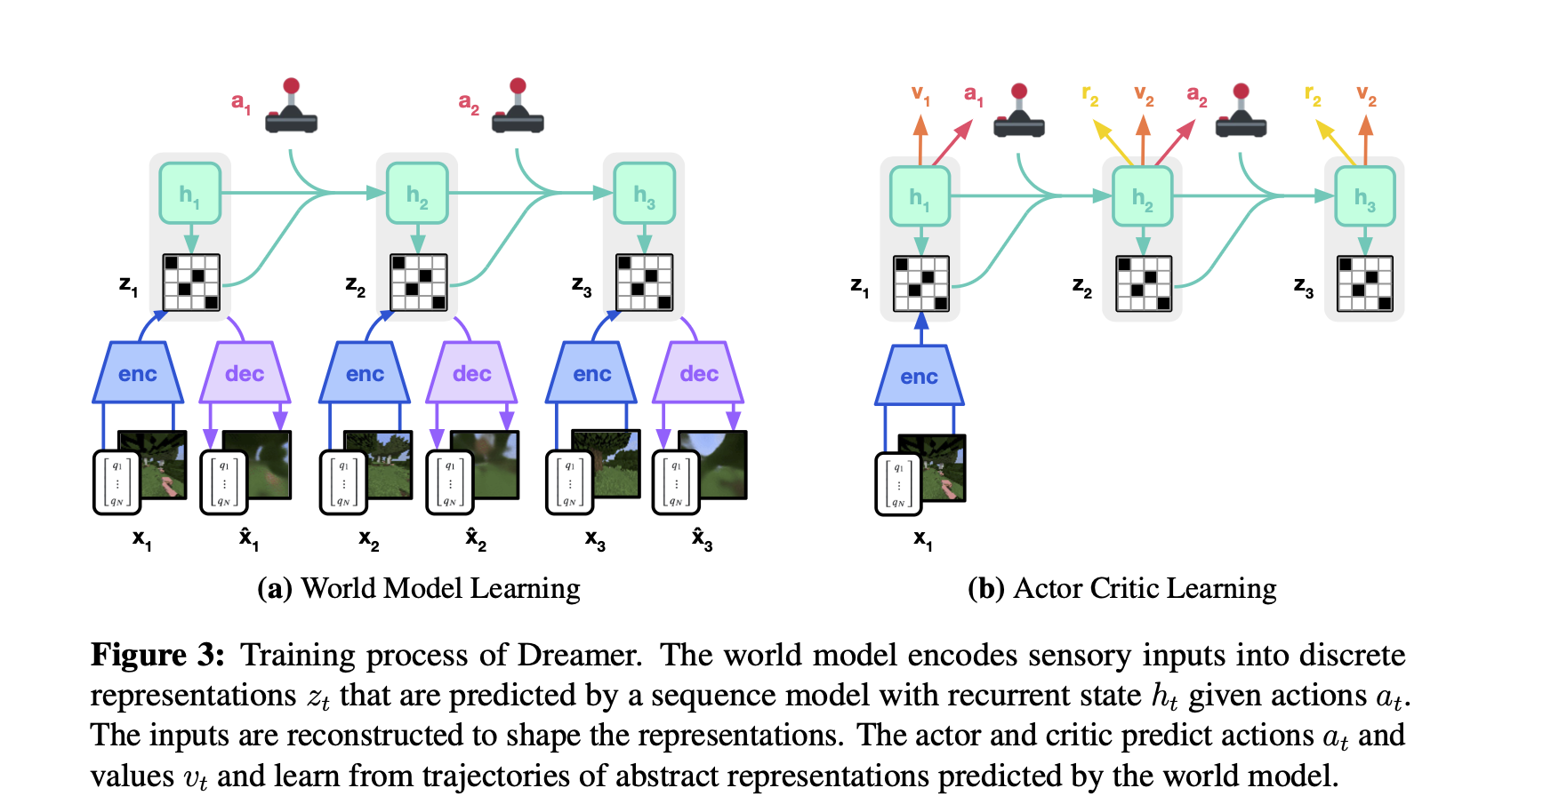
Relevant Works [4]
Training the Controller in Actor-Critic Learning
Action predicted by a Function using World Model Embedding
Notes:
[4]: (Hafner et al., 2023)
F: The RL controller needs to be trained – MLP is the usual choice
t: the current timestamps (episodes)

Slide 13
Relevant Works
How those results may influence our team’s designing of HANOI-WORLD
  JEPA for learning from difference modality
  Design the World Model is a hierarchical system for layering in reasoning
  Action-Critic training paradigm use for training the R.L controller

Slide 14
Methodology
Our team attempts to design the HANOI-WORLD system, which contains 3 different modules
  The Encoder the 2D-BEV images (radius of 70 - 100 arround ego)
    Pre-train based JEPA-encoder for BEV-encoding
  The Imaginary World Model
    RSSM-model for imagination & overshoot the future based on history
    MLP layers (Rewarding & Continuation)
  The RL-controlling head for automation

Slide 15
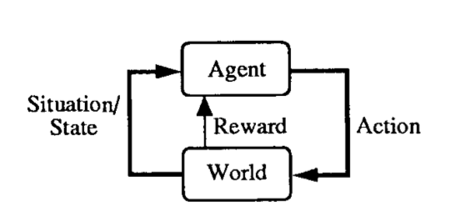
Methodology - Actor-Critic controller
It’s recommended to design the layer to be simple for easier debugging & parameter tuning [1], [4], [5]
The architecture we choose for actor-critic: MLP (Multi-Layer Perceptron) – based on the DreamerV3
The Action Critic Framework for problem formulation (Sutton, 1991)
Notes:
Images from: Sutton, R. (1991). Dyna, an integrated architecture for learning, planning, and reacting. SIGART Newsletter, 2(4), 160–163. https://doi.org/10.1145/122344.122377
[1]: (Ha & Schmidhuber, 2018)
[4]:(Hafner et al., 2023)
[5]: (Hansen et al., 2023)

Slide 16
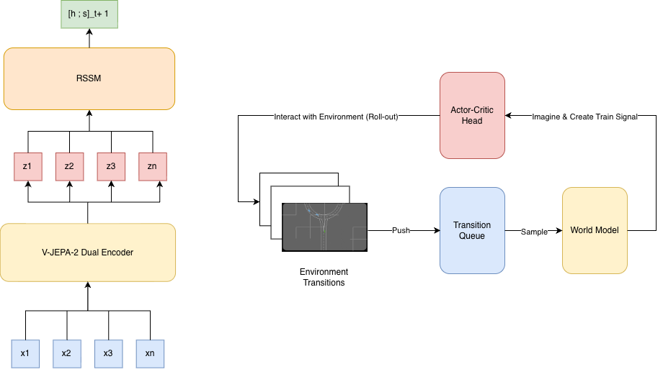
(World Model Architecture)
(The System Architecture)

Slide 17
Methodology - Simplified Architecture
  Action-Critic controller
    Deciding by using the outcome from WorldModel
    Returned Action: Acceleration, Steering Angle (Radian)

Slide 18
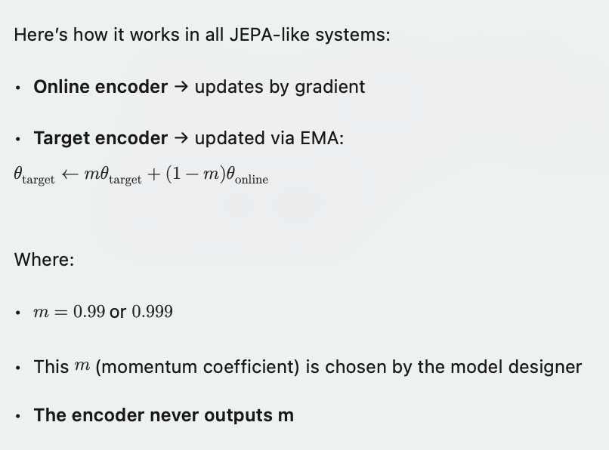
EMA Training for JEPA
Notes:
Based on Blogpost: https://ai.meta.com/blog/v-jepa-2-world-model-benchmarks

Slide 19
Methodology - Train the Actor-Critic [4]
Prerequisite: The latent representation (dream) has to be closest to the world (World model needs to train separately)
The Critic learns to judge those dreams — how much reward each path gives.
The Actor learns to act inside those dreams to reach the best reward.
Notes:
[4]:(Hafner et al., 2023)

Slide 20
Methodology - Train the Actor-Critic
Training Algorithm:
  REINFORCE-style [11] & [4] inside latent embedding
  If a dream leads to a good outcome, increase its probability.
  Else if the dream leads to a bad outcome, decrease its probability.
  The actor shall perform the action based on the dream been selected

Slide 21
Methodology - Dataset
The dataset that we shall use:
  NuScenes dataset: [10]
    360 degrees Sensor (contain LiDAR sensor)
    Rich map context (road, lane, static object)
    3D object annotation
    LiDAR semantic label (road, sidewalk,…)
    Scene (1000 scenes, each 20 s from Boston & Singapore)
Notes:
(Caesar et al., 2019)

Slide 22
Methodology - Dataset
NuPlan Dataset: [6]
  Driver History
  Sensor data as NuScene
  Ego-State of the Ego Vehicle
  Surrounding Agent Labeling
  Map Data
Notes:
[6]: (Caesar et al., 2021)
[7]: (Yan et al., 2025)

Slide 23
Methodology - Our Experiment Plan
Step 1:
  Finetune the HANOI-WORLD’s encoder on the Observatory Data (nuScene & nuPlan) for yielding qualifiable imaginary embedding
Step 2:
  Training the RSSM & Actor-Critic network with fine-tuned Encoder on
Highway-Env environments

Slide 24
Methodology—Our Experiment Plan
Step 3:
  Inference of the HANOI-WORLD on the Highway-Environment (Intersection, Merge, Roundabout Environment) -> for checking the model adaptability & generalizability

Slide 25
Methodology—Our Experiment Plan
For performance comparison, we shall compare HANOI-WORLD with different world-model implementations include:
DreamerV3 used by [4]
VQ-VAE based design used by [12]

Slide 26
Methodology— Training Setup
Experimental Training Setup
Compare models across three environments
Gymnasium package driving benchmarks used
Highway, Merge, Roundabout scenarios
VQ-VAE plus DreamerV3 training
HanoiWorld trained separately baseline
Training Configuration Details
DreamerV3 & VQ-VAE trained 100k steps with PPO for policy learning
HanoiWorld trained five-thousand steps
with REINFORCE used for optimization

Slide 27
Methodology— Environment Setup
Environments Considered
Highway-Env straight driving dynamics
Merge-Env lane-merging complexity
Roundabout-Env circular traffic interactions
Increasing difficulty across environments
Tests generalization and robustness
Implementation
Pretrained V-JEPA 2 encoder on NuScene & NuPlan dataset (pre-processed LiDAR cloud to 2D RGB)
RSSM & Policy networks are trained on the gynasim
Notes:
From: https://github.com/Farama-Foundation/HighwayEnv

Slide 28
Methodology – Metric & Evaluation
Our team chooses these metrics due to their simplicity and interpretability
  Collision Rate ↓
  Average Reward / Score ↑
Notes:
[1] (Ha & Schmidhuber, 2018 — World Models)
[8](Gao et al., 2024 — CarDreamer)
[9](Min et al., 2024 — DriveWorld)
[7] (Yan et al., 2025 — DiffAD / Motion-Planner Frameworks)
Collision Rate ↓
Success Rate ↑
Average Displacement Error (minADE) ↓
Route Completion ↑
Lateral Deviation ↓
Average Reward / Score (↑)
Driving Score (↑)

Slide 29
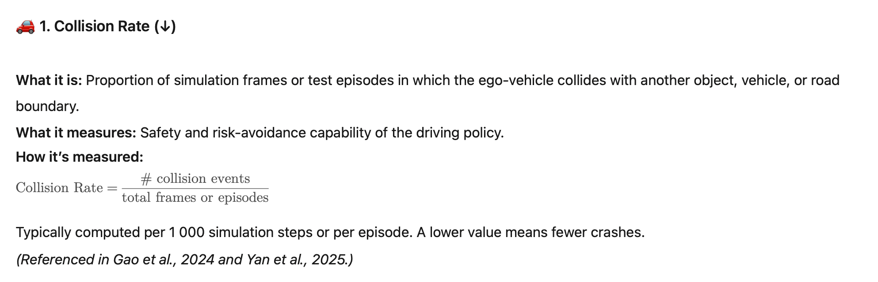

Slide 30
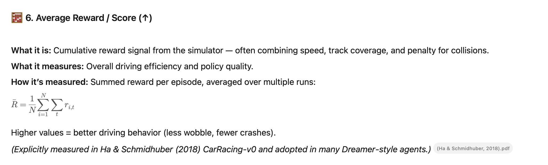
Notes:
Summed reward across steps within episode

Slide 31
What each metric means
Aspect | Metric | What They Reflect
Safety | Collision Rate | Risk & Rule violation avoidance
Efficiency | Average Reward /Score | Speed-accuracy trade-off

Slide 32
Evaluation Result - Collision Rate (100 episodes)
ENV | Highway | Merge | Roundabout
DreamerV3 | 0.550 ± 0.497 | 0.030 ± 0.171 | 0.500 ± 0.500
VQ-VAE | 1.000 ± 0.000 | 0.290 ± 0.454 | 0.570 ± 0.495
HANOI-WORLD | 0.20 ± 0.40 | 0.97 ± 0.170 | 0.340 ± 0.473

Slide 33
Evaluation Result - Average Reward/Score (100 episodes)
ENV | Highway | Merge | Roundabout
DreamerV3 | 51.065 ± 52.700 | 41.973 ± 2.896 | 9.423 ± 6.171
VQ-VAE | 3.121 ± 12.047 | 30.114 ± 11.664 | 3.826 ± 4.643
HANOI-WORLD | 13.163 ± 23.277 | 13.48 ± 5.703 | 9.818 ± 6.252
Notes:
mean +- std

Slide 34
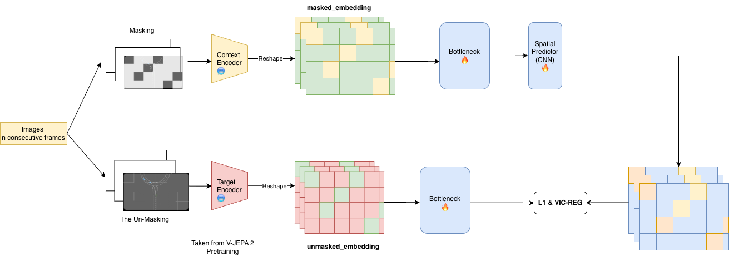
Appendix - Encoder Architecture

Slide 35
Appendix - Training Objective
For HanoiWorld - apply the loss as [4]
World Model Losse (Dynamicity & Imaginary)
Actor (Policy) Losses (Learn what to do)
Critic (Value) Losses (How well is the agent’s performance)
For JEPA-Encoder Fine Tuning as [14], [15]
L1-Alignment loss (structure constrain)
VIC-Regularization (embedding collapse prevention)

Slide 36
Appendix - HanoiWorld Loss
1️⃣ World Model Losses (Learn dynamics & imagination)
Reconstruction loss: predict observations (image, proprioception, etc.)
Reward prediction loss: predict scalar reward
Discount / termination loss: predict episode continuation
KL loss (posterior ↔ prior): latent consistency & regularization
Representation regularization: stabilize latent dynamics
2️⃣ Actor (Policy) Losses (Learn what to do)
Expected return maximization (imagined rollouts)
Value-aware policy gradient (uses learned value)
Entropy regularization (encourage exploration)
Continuation-weighted objective (long-horizon focus)
Latent-space optimization (acts in imagination, not pixels)

Slide 37
Appendix - HanoiWorld Loss (cont)
3️⃣ Critic (Value) Losses (Learn how good it is)
Value regression loss (predict expected return)
λ-return / TD target loss (long-term credit assignment)
Bootstrapped targets (from imagined trajectories)
Discount-aware value loss
Stabilization via slow targets

Slide 38
Reference
[1]: Ha, D., & Schmidhuber, J. (2018). World Models. World Models, 1(1), e10. https://doi.org/10.5281/zenodo.1207631
[2]: Lecun, Y. (2022). A Path Towards Autonomous Machine Intelligence. https://openreview.net/pdf?id=BZ5a1r-kVsf
[3]: Assran, M., Duval, Q., Misra, I., Bojanowski, P., Vincent, P., Rabbat, M., LeCun, Y., & Ballas, N. (2023). Self-Supervised Learning from Images with a Joint-Embedding Predictive Architecture. ArXiv:2301.08243 [Cs, Eess]. https://arxiv.org/abs/2301.08243

Slide 39
Reference
[4]: Hafner, D., Pasukonis, J., Ba, J., & Lillicrap, T. (2023, January 10). Mastering Diverse Domains through World Models. ArXiv.org. https://doi.org/10.48550/arXiv.2301.04104
[5]: Hansen, N., Su, H., & Wang, X. (2023). TD-MPC2: Scalable, Robust World Models for Continuous Control. ArXiv.org. https://arxiv.org/abs/2310.16828v2
[6]: Caesar, H., Kabzan, J., Tan, K. S., Fong, W. K., Wolff, E., Lang, A., Fletcher, L., Beijbom, O., & Omari, S. (2021). NuPlan: A closed-loop ML-based planning benchmark for autonomous vehicles. ArXiv.org. https://arxiv.org/abs/2106.11810

Slide 40
Reference
[7]: Yan, Z., Li, J., Hang, P., & Sun, J. (2025). OnSiteVRU: A High-Resolution Trajectory Dataset for High-Density Vulnerable Road Users. ArXiv.org. https://arxiv.org/abs/2503.23365
[8]: Gao, D., Cai, S., Zhou, H., Wang, H., Soltani, I., & Zhang, J. (2024). CarDreamer: Open-Source Learning Platform for World Model based Autonomous Driving. ArXiv.org. https://arxiv.org/abs/2405.09111
[9]: Min, C., Zhao, D., Xiao, L., Zhao, J., Xu, X., Zhu, Z., Jin, L., Li, J., Guo, Y., Xing, J., Jing, L., Nie, Y., & Dai, B. (2024). DriveWorld: 4D Pre-trained Scene Understanding via World Models for Autonomous Driving. ArXiv.org. https://arxiv.org/abs/2405.04390

Slide 41
Reference
[10] Caesar, H., Bankiti, V., Lang, A. H., Vora, S., Liong, V. E., Xu, Q., Krishnan, A., Pan, Y., Baldan, G., & Beijbom, O. (2019). nuScenes: A multimodal dataset for autonomous driving. Arxiv.org. https://arxiv.org/abs/1903.11027
[11] Williams, R. J. (1992). Simple statistical gradient-following algorithms for connectionist reinforcement learning. Machine Learning, 8(3-4), 229–256. https://doi.org/10.1007/bf00992696
[12] Robine, J., Uelwer, T., & Harmeling, S. (2020). Smaller World Models for Reinforcement Learning. ArXiv.org. https://arxiv.org/abs/2010.05767
[13] Hafner, D., Lillicrap, T., Fischer, I., Villegas, R., Ha, D., Lee, H., & Davidson, J. (2019). Learning Latent Dynamics for Planning from Pixels. ArXiv:1811.04551 [Cs, Stat]. https://arxiv.org/abs/1811.04551

Slide 42
Reference
[14]: Assran, M., Duval, Q., Misra, I., Bojanowski, P., Vincent, P., Rabbat, M., LeCun, Y., & Ballas, N. (2023). Self-Supervised Learning from Images with a Joint-Embedding Predictive Architecture. ArXiv:2301.08243 [Cs, Eess]. https://arxiv.org/abs/2301.08243
[15]: Bardes, A., Ponce, J., & LeCun, Y. (2022). VICReg: Variance-Invariance-Covariance Regularization for Self-Supervised Learning. ArXiv:2105.04906 [Cs]. https://arxiv.org/abs/2105.04906

